Slide 1
CS2523 - Computer Organisation and Assembly Language
Addressing Modes - Effective Address
Addressing Modes - Physical Address
Address Wraparounds

Slide 2
Addressing Modes
Direct Access Mode
; Default segment = ds
mov ax, [0x1234] ; word move
mov ah, [0x1234] ; byte move
mov byte[0x1234], 10
mov word[0x1234], 10
Notes:
Whenever we use the offset addressing like mov ax, [0x1234] so here we are using to copy a fix value 1234th data of the memory so the default segment from which it will pick this value is the Data Segment.

Slide 3
Addressing Modes
Base Addressing
; Default segment = ds
mov ax, [bx]
mov byte [bx], 10
mov word [bx], 10
; Default segment = ss
mov ax, [bp]
mov byte [bp], 10
mov word [bp], 10
Notes:
The above is the example of base addressing the two registers are bx and bp register so when we use the bx by default it will use the bx segment and when we will take the bp than by default the segment will be bp.

Slide 4
Addressing Modes
Index Addressing
; Default segment = ds
mov ax, [si]
mov byte [di], 10
mov word [si], 10
Notes:
The above is the example of the index register and these use the Data Segment as their default register.

Slide 5
Addressing Modes
Base + Offset Addressing
; Default segment = ds
mov ax, [bx+0x0100]
mov byte [bx+0x100], 10
mov word [bx+0x100], 10
; Default segment = ss
mov byte [bp+0x10], 10
mov word [bp+0x100], 10

Slide 6
Addressing Modes
Index + Offset Addressing
; Default segment = ds
mov ax, [si+0x0100]
mov byte [di+0x100], 10
mov word [di+0x100], 10
mov byte [si+0x10], 10
mov word [si+0x0100], 10
Notes:
In this case weather we use the si or di register the default place where they will go to get the data is the Data segment.

Slide 7
Addressing Modes
Base + Index Addressing
; Default segment = ds
mov ax, [bx+si]
mov byte [bx+si], 10
mov word [bx+di], 10
; Default segment = ss
mov byte [bp+si], 10
mov word [bp+di], 10
Notes:
Both the register will be added and the result be used as an address in the default segment which will be used to get the data and the default segment will be based on the fact that they use bx or bp.

Slide 8
Addressing Modes
Base + Index + Offset Addressing
; Default segment = ds
mov ax, [bx+si+0x0100]
mov byte [bx+si+0x0100], 10
mov word [bx+di+0x0100], 10
; Default segment = ss
mov byte [bp+si+0x0100], 10
mov word [bp+di+0x0100], 10
Notes:
The constant value + the value of the source index + the value of the base will be used to index into the default segment to fetch the data. The default segment will depend upon the fact that we use bx or bp.

Slide 9
Addressing Modes
General Form
[base + index + offset]

Slide 10
Illegal Addressing
Example
mov al, [bl] ; Address cannot be 8-bit
; has to be 16-bit

Slide 11
Illegal addressing

Slide 12
Illegal Addressing
Example
mov ax, [bx-si] ; Registers cannot be ; subtracted
Notes:
In the iapx88 architecture we can not subtract a register.

Slide 13
Illegal Addressing
Example
mov ax, [bx+bp] ; Two bases cannot be ; used in one addressing
Notes:
Which means that we can not use two base registers in one instruction

Slide 14
Illegal Addressing
Example
mov ax, [si+di] ; Two indices cannot be ; used in one addressing
Notes:
The two registers can not come like this because one register can be from the base family and one can be from the index family both can not be same in one instruction that is why we use different names in the first place to differentiate between different types of registers

Slide 15
Physical Address Calculation
[cs:bx+si+0x0700] BX = 0x0100
SI = 0x0200
CS = 0x1000
Effective Address =
EA = Base + Index + Offset
EA = 0x0100 + 0x0200 + 0x0700
= 0x0A00
Physical Address = Segment*0x10+EA
= 0x1000*0x10+0x0A00
=0x10000+0x00A00= 0x10A00
Notes:
To calculate the physical address segment can be multiplied by 16 in decimal or the 10 in hexadecimal or shifted by four bits to the right; all of these are equivalent operations.

Slide 16
Physical Address Calculation
[bx+0x7000] BX = 0x9100
DS = 0x1500
Effective Address =
EA = Base + Index + Offset
= 0x9100 + 0x0000 + 0x7000
= 0x10100 ; 17-bits !
= 0x0100 ; Segment wrap ; around
Notes:
When we add bx with 0x7000 in the first line of the code than in hexadecimal we get 0x7000
0x9100 = 0x10100 here the 1 in the msb side is an overflow in such a case when we get a carry than we drop the carry bit so the remaining number is 0x0100 this is called a wrap around so here we can visualize the segment like a circle that if we move to the next step ahead of the last step than the segment takes us back to the first part of the segment. So in this case the physical address will be
0x 00100
0x15000
---------
0x15100
Now we do the example of the wrap around the memory

Slide 17
Physical Address Calculation
[bx+0x7000] BX = 0x9100
DS = 0x1500
Effective Address =
EA = 0x0100 ; Segment wrap ; around
Physical Address = Segment*0x10+EA
= 0x1500*0x10+0x00100
=0x15000+0x00100
= 0x15100

Slide 18
Physical Address Calculation
[bx+0x0100] BX = 0x0100
DS = 0xFFF0
Effective Address =
EA = Base + Index + Offset
= 0x0100 + 0x0000 + 0x0100
= 0x0200
Physical Address = Segment*0x10+EA
= 0xFFF0*0x10+0x00200
=0xFFF00+0x00200
= 0x100100 ; 24-bits !
= 0x00100 ; memory wrap ; around
Notes:
This wrap around will be at the level of the memory. In this case if we look at the segment register i.e. DS and now this value is such that if we add even one more number in this than the segment value if exceed the limit of the memory i.e. 20 bits. Now when we add all these the value we get is 0x100100 here 1 Hex digit is an extra and it will be dropped so the actual value that we will get is 0x00100

Slide 19
Address Wraparound

Slide 20
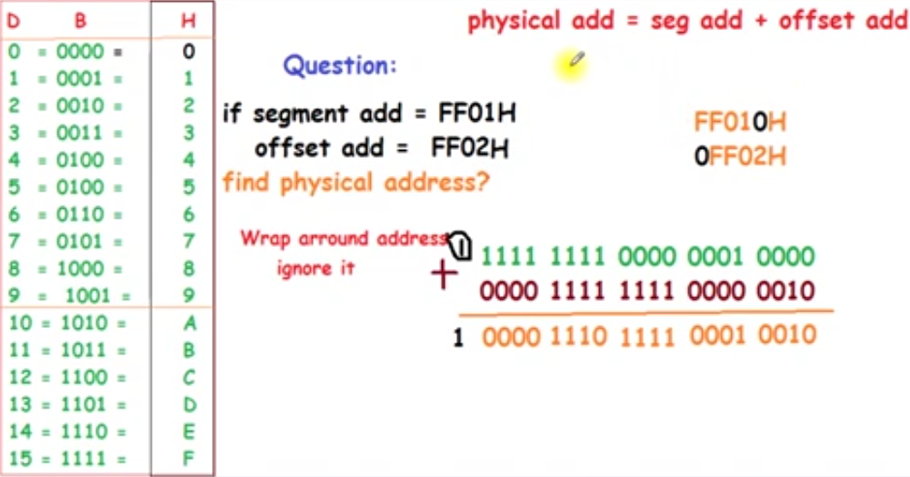
Address Wraparound

Slide 21
Address Wraparound
2 Types of wraparounds.
Address Wraparound Within a Single Segment
Address Wraparound inside the whole physical memory

Slide 22
Address Wraparound Within a Single Segment
Segment wraparound occurs when during the effective address calculation a carry is generated.
This carry is dropped giving the effect that when we try to access beyond the segment limit, we are actually wraparound to the first cell in the segment.
For example if BX=9100, DS=1500 and the access is [bx+0x7000] we form the effective address 9100 + 7000 = 10100.
The carry generated is dropped forming the actual effective address of 0100.

Slide 23
Address Wraparound Within a Single Segment
Just like a circle when we reached the end we started again from the beginning.
An arc at 370 degrees is the same as an arc at 10 degrees.
We tried to cross the segment boundary and it pushed us back to the start.
This is called segment wraparound. The physical address in the above example will be 15100.

Slide 24
Address Wraparound inside the whole physical memory
The same can also happen at the time of physical address calculation.
For example BX=0100, DS=FFF0 and the access under consideration is [bx+0x0100]. The effective address will be 0200 and the physical address will be 100100.
This is a 21 bit answer and cannot be sent on the address bus which is 20 bits wide.
The carry is dropped and just like the segment wraparound our physical memory has wrapped around at its very top.

Slide 25
Address Wraparound inside the whole physical memory
When we tried to access beyond limits the actual access is made at the very start.
This second wraparound is a bit different in newer processor with more address lines.

